Slide 1
Transparent Opacity
September 2011
Mitchell Joe

Slide 2
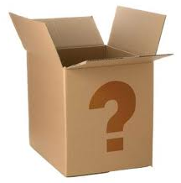
What does Hotwire sell?
The fact that we sell opaque products should be transparent to our customers.
It’s not.
Everyday, our potential customers say things like:
“Where is the hotel name please?!?! Dumb site!”

Slide 3
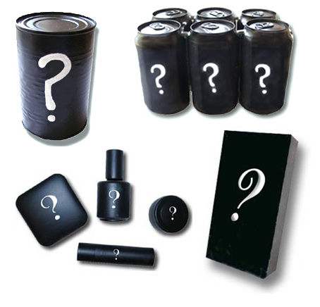
Transparency
Transparency is good. It’s tied up with honesty and trust.
People who think that they’re buying organic apples should be receiving organic apples.
A problem we face is that many people aren’t even sure what’s on our shelves. They don’t know that we sell opaque products. That’s kind of strange.
And it’s hard to get excited about something when you don’t know what it is.

Slide 4
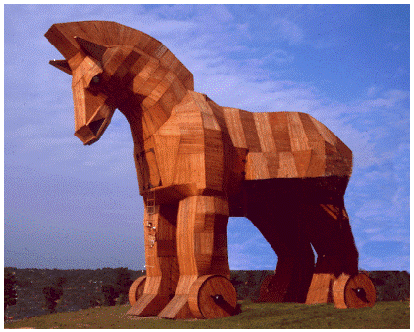
Unpleasant Surprises
Many people don’t understand why our products are discounted.
If we fail to make it clear up front, then they will feel tricked when they find out.
People should be told immediately about the tradeoff between price and opacity.
People like knowing what they’re buying.

Slide 5
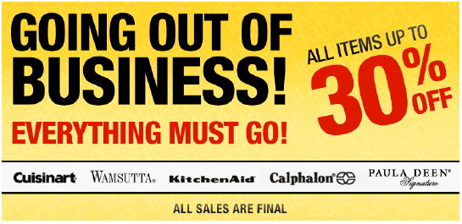
Known Tradeoffs and Discounts
People expect to pay less for:
muffins baked yesterday
because they taste worse
goods from a going out of business sale
because the owner is desperate to sell them
very ripe fruit
because it will spoil soon
calendars in February
because part of the year is already over
Our main product is:
hotel rooms that would otherwise go unsold, which are discounted
because the hotel prefers to make some money rather than no money
How well do we communicate that this is the nature of our discounted product?

Slide 6
How do others communicate that they’re selling opaque products?

Slide 7
Product Name
Travelocity
Top Secret Hotels
Expedia
Unpublished Rate Hotels
Priceline
Name Your Own Price
Hotwire
Hot Rate
positive, exclusive, you’re being let in on a secret
positive, rare, you’re discovering something that others don’t know about
informative, positive, reinforces the fact that you’re getting a discount, puts you in control of the discount, it’s a game
positive, not informative, matches our name

Slide 8
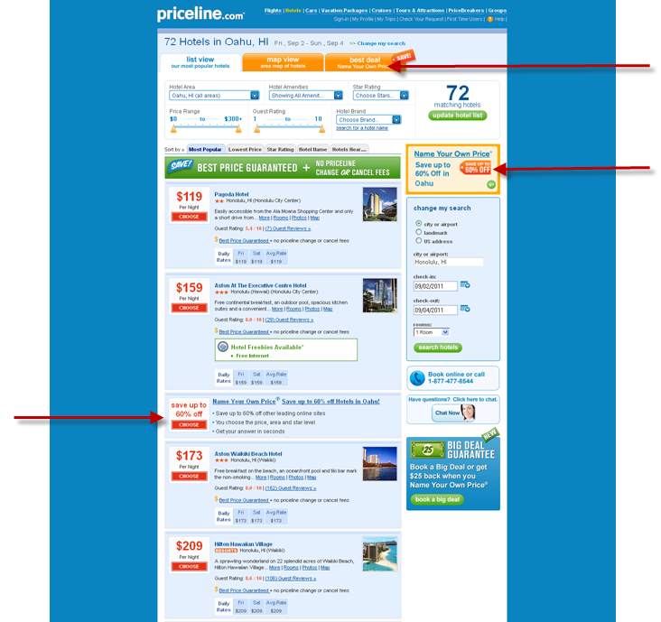
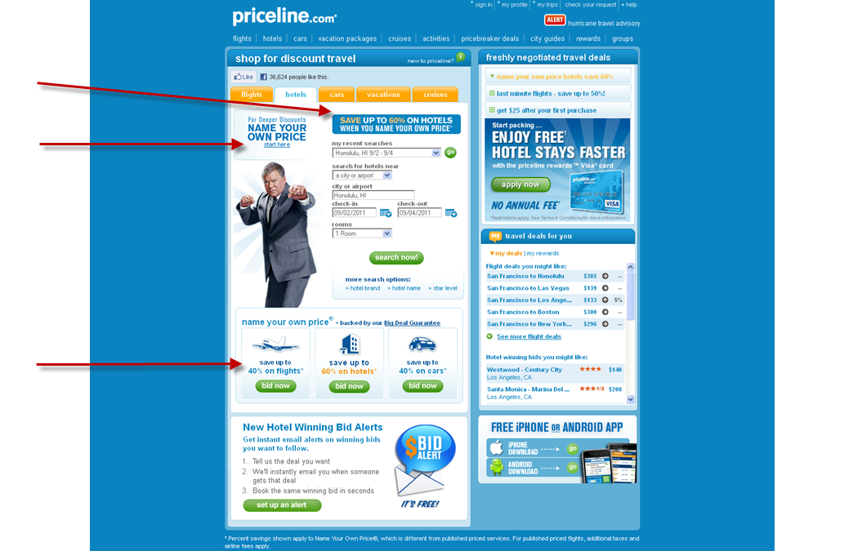
Placement
Priceline informs the user of its opaque product by giving it prominent placements throughout the site.
Homepage
ad
ad
module/buttons
Search Results
tab
cross-sell ad in the margin
result/speedbump

Slide 9
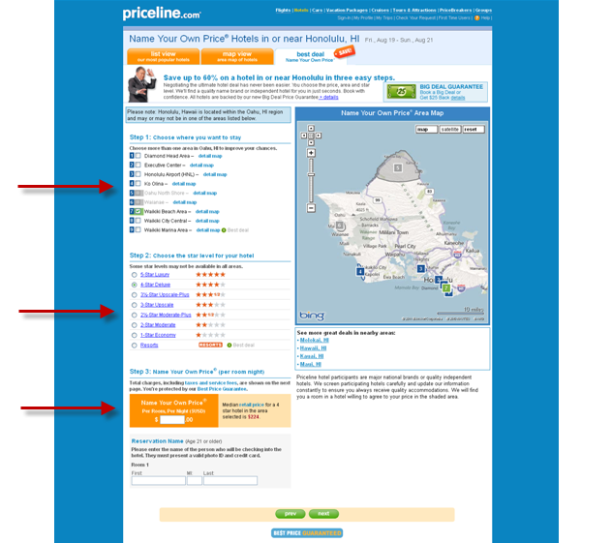
Action and Distraction
Priceline communicates the opacity of their hotels’ acceptable price ranges by showing the median price and letting the user guess where the lower limit is.
This very interesting thing is that being preoccupied with the opacity of the acceptable price range distracts the user from thinking about the opacity of the hotel identity.
The user is asking herself: “What price should I bid?”, not “Which hotels are these?”.
An additional benefit of the bidding model is that the savings that user is receiving are very obvious.

Slide 10
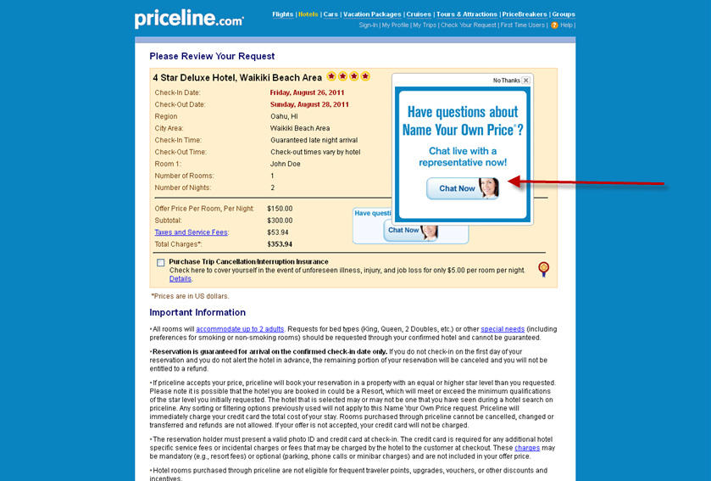
IM Chat
Links to chat appear throughout the booking path.
If you are inactive for long enough during the Review Details page, then a window prompting you to chat pops up.
This is a nice proactive way to answer any questions about the product that the user may have.
It’s also more personal.

Slide 11
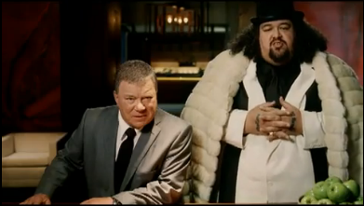
TV
Priceline’s website leads with retail but its TV ads are all about opaque education.

Slide 12
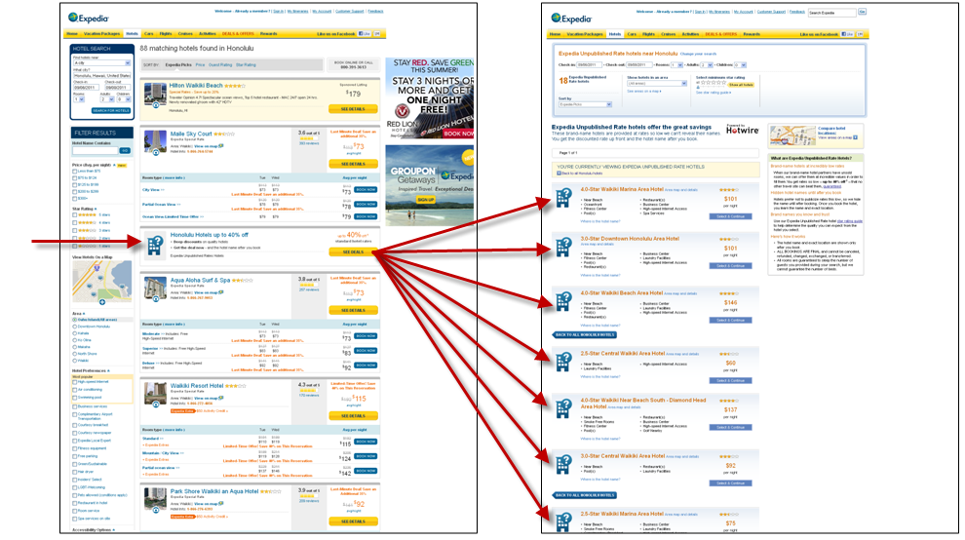
Placed Next to Retail Products
Expedia and Travelocity place their opaque result next to a retail result, which then leads to a page full of opaque results. Here’s Expedia:

Slide 13
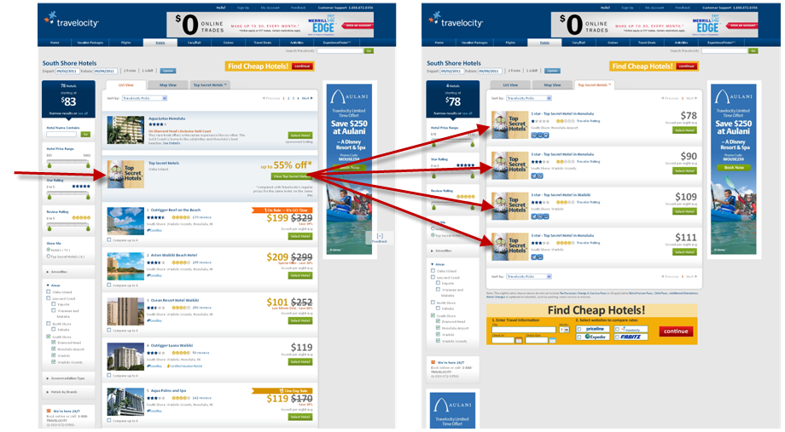
Placed Next to Retail Products
Here’s Travelocity:

Slide 14
Visual Communication
Opaque products should look similar to but different from retail products.
Replace the retail photo with an opaque placeholder.
Use drastically different words.

Slide 15
Photo Placeholder
Expedia’s placeholder conveys opacity well with the question mark symbol.
Travelocity’s placeholder conveys opacity using the words “Top Secret Hotels” and also through the gnome’s eyes, which are covered by cucumbers so it is blind to the identity of the hotel, in a very relaxed “I’m at a spa” sort of way.

Slide 16
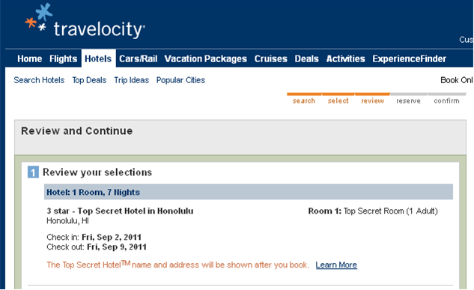
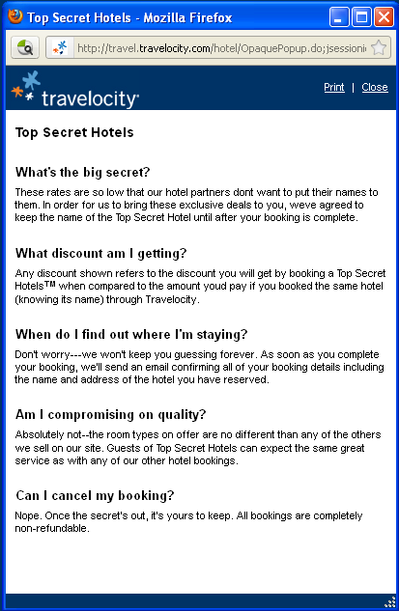
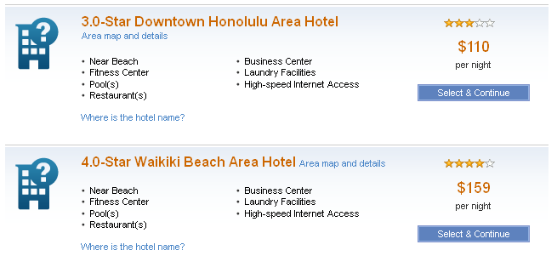
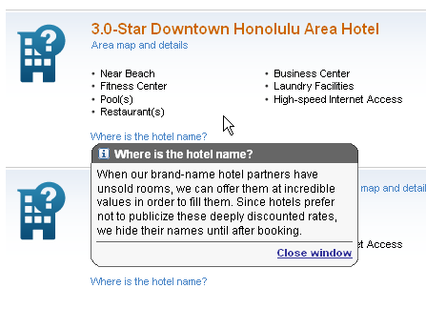
Help Links on User’s Path

Slide 17
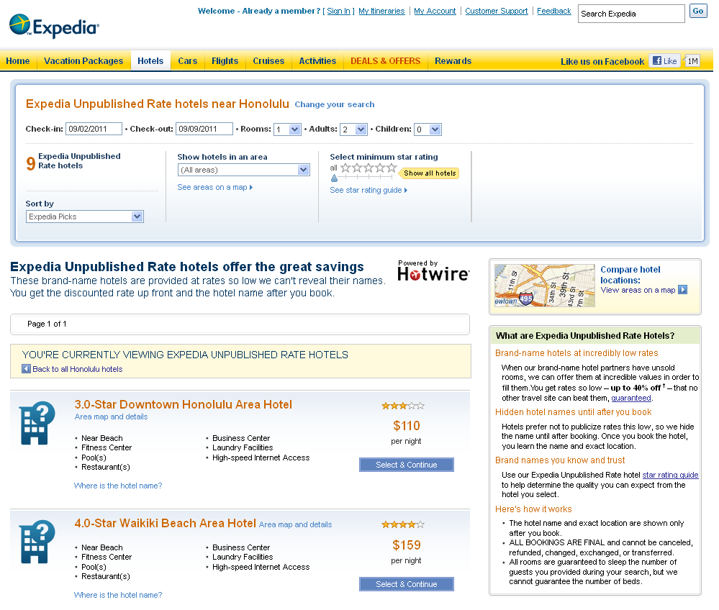
Education Modules Near User’s Path

Slide 18
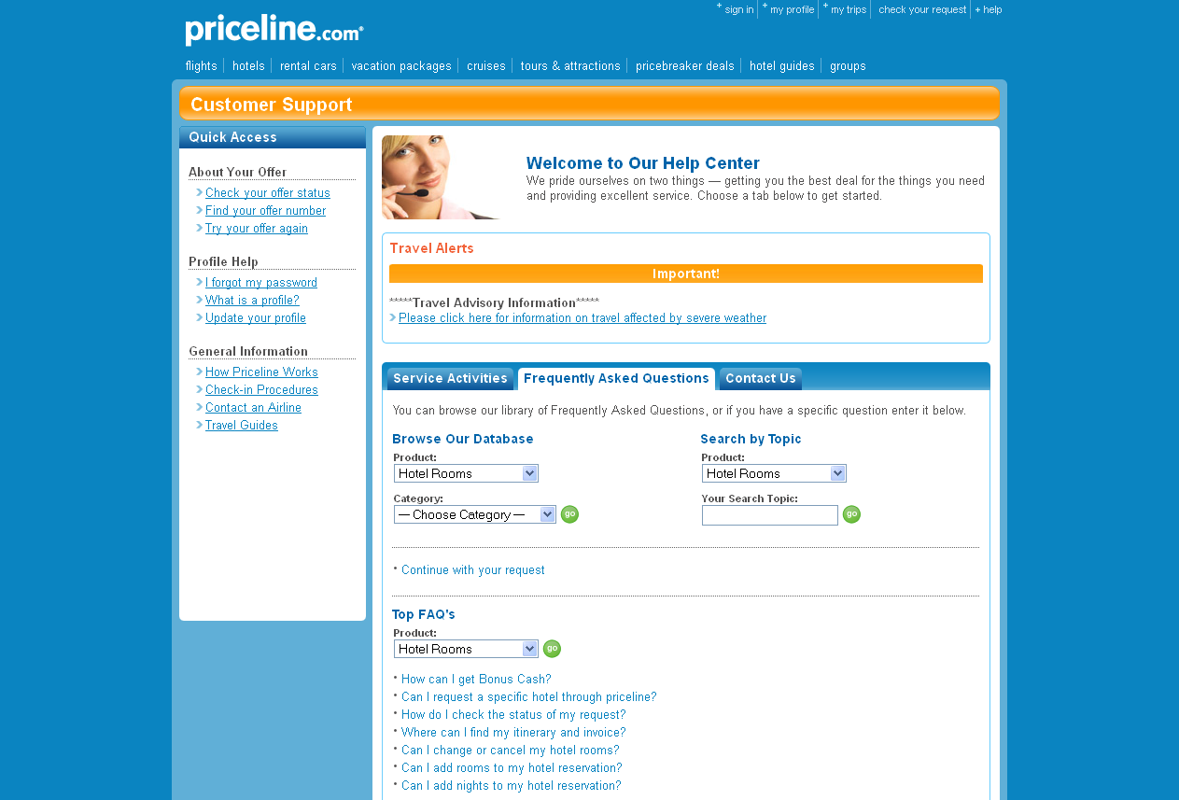
FAQs Off User’s Path

Slide 19
Words
Words may be colorless and unexciting to the eye but they are far more precise than a gnome with cucumbers on its eyes.
“If we accept your offer, we'll immediately charge the credit card you provide to us. Please note, you will not be provided with a list of hotel options.” (Priceline)
“When our brand-name hotel partners have unsold rooms, we can offer them at incredible values in order to fill them. Since hotels prefer not to publicize these deeply discounted rates, we hide their names until after booking.” (Expedia)
“Shhh, These rates are so low that our hotel partners don't want to put their names to them. In order for us to bring you these exclusive deals, the name of the hotel will be hidden from you until booking is complete.” (Travelocity)
“When brand-name hotels use us to fill rooms that would otherwise go unsold, their prices are deeply discounted. Hotels don't want to publicize rates this low, so we hide their name until after booking.” (Hotwire)

Slide 20
How do others communicate opacity in non-travel industries?

Slide 21
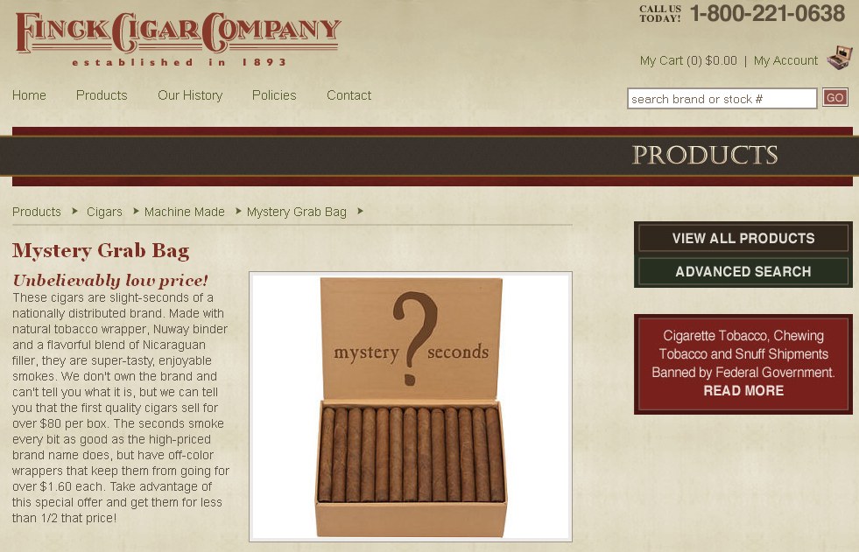
Cigars
“Factory seconds” are cigars from a reputable company that are discounted because they have some imperfection that is unrelated to the quality of the tobacco inside, such as an off-color wrapper.
Uses the question mark symbol
Product name is “Mystery Grab Bag”
Explains the trade-off of a slight imperfection in the wrapper color that affects how it looks but doesn’t affect how the cigar smokes.

Slide 22
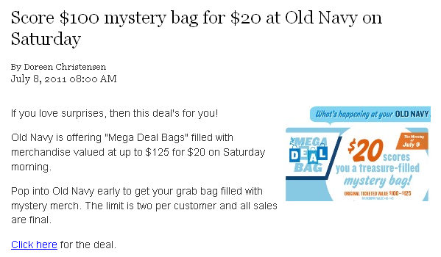
Clothes
Old Navy offered $100 of mystery merchandise for $20.
Product name is “Mystery Bag”
Explains that all sales are final
It’s clear that the tradeoff is that you don’t know what’s in the bag.

Slide 23
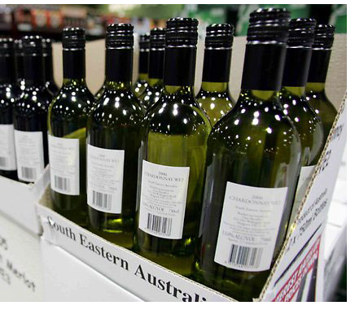
Wine
In Australia, they sell “cleanskins”, which are bottles of wine with no label or a minimal label.
This presentation allows wineries to sell off excess inventory without damaging their brand.
The lack of label or the no-frills black and white label communicates that it is a cleanskin.
To preserve opacity, the consumer is told only basic information about the wine, such as the varietal, region, and alcohol content.
The tradeoff is clear: a lower-than-normal price for less information about the source of the wine.
This is the front of the bottle. No brand.
No other label.

Slide 24
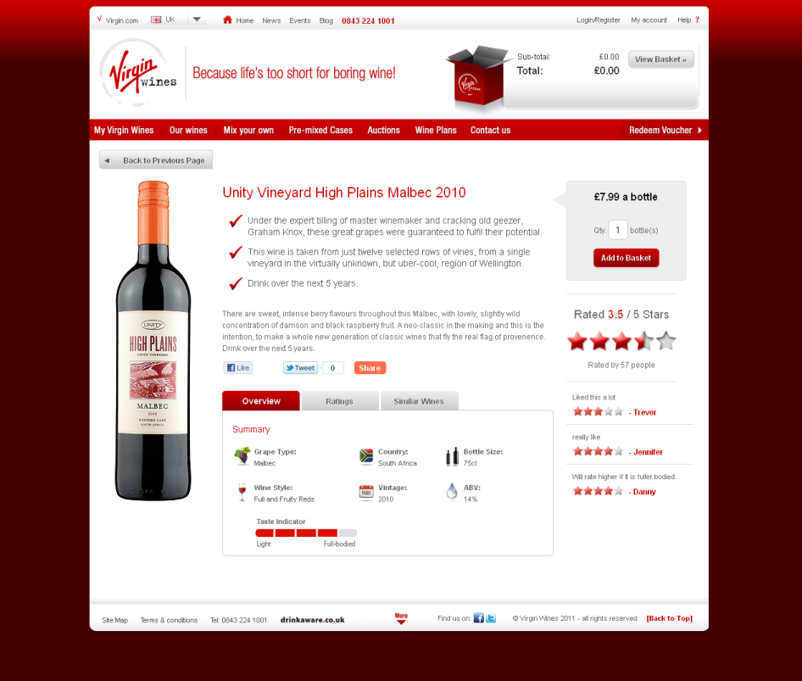
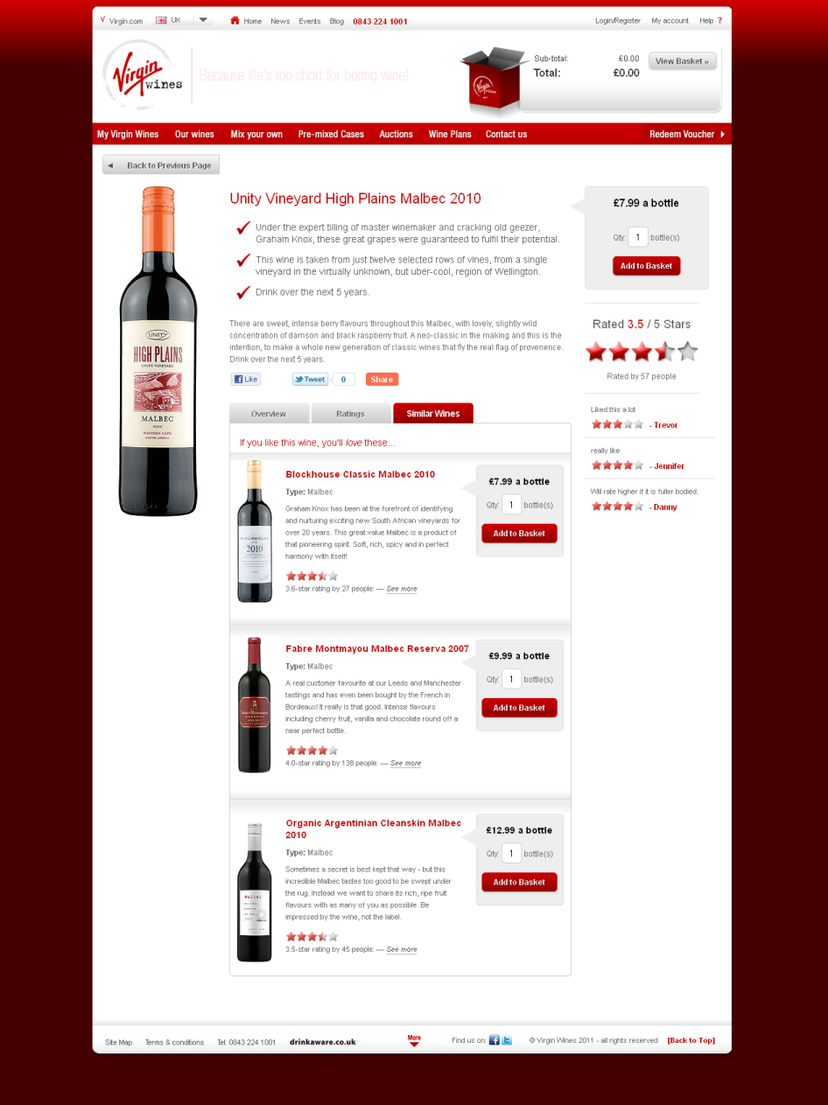
Wine
retail
retail
opaque
Virgin places cleanskins under a tab called “Similar Wines”.

Slide 25
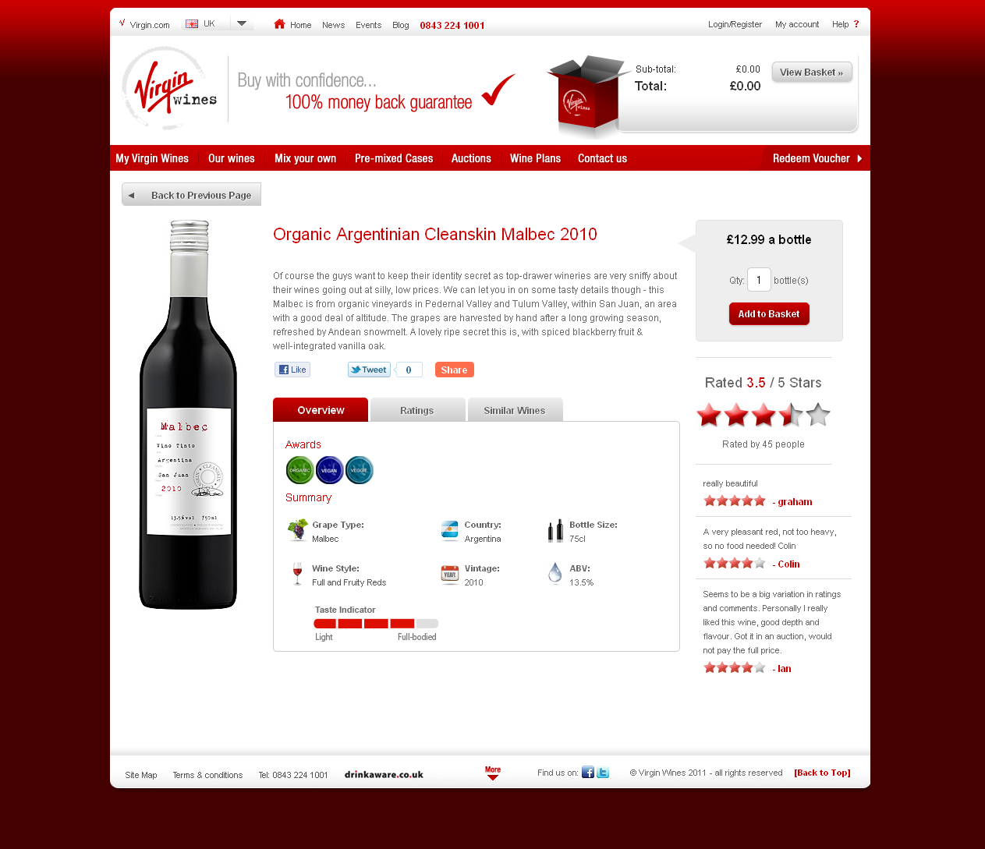
Wine
“Cleanskin” is in the product name.
“Be impressed by the wine, not the label.”
Where you expect to see the brand name, you see the varietal.

Slide 26
How do we communicate that we’re selling opaque products and
how can we improve?

Slide 27
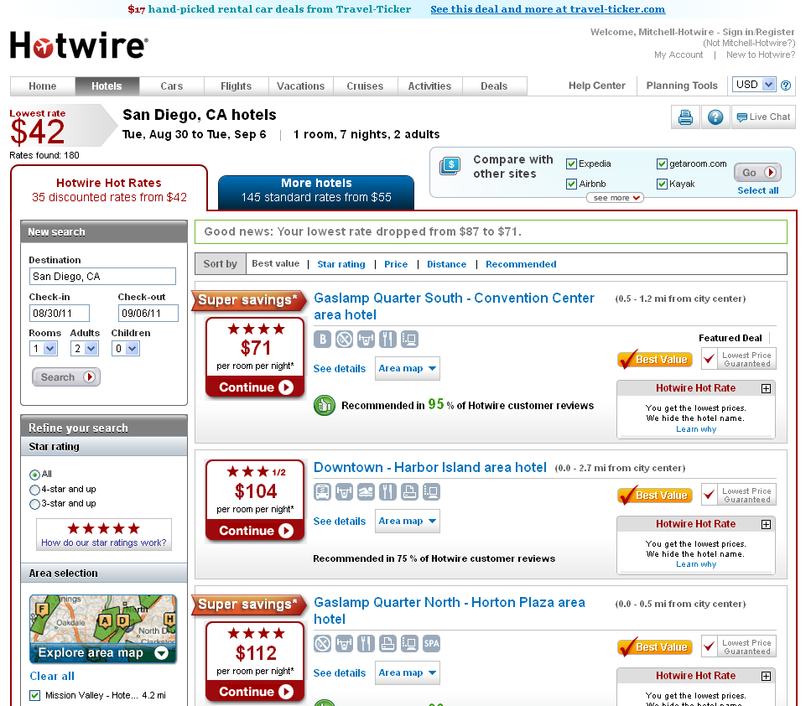
Not Alongside Retail
We currently lead with our opaque product and have a separate tab for retail hotels.
This might cause people to miss the Retail tab. We saw this in the usability lab. No one navigated there without prompting. They didn’t feel there was any reason to.
We lose an opportunity to educate by not juxtaposing the retail and opaque result modules.

Slide 28
No Visual that Denotes “The Unknown”
Expedia has a placeholder that denotes the unknown.
Travelocity has a placeholder that denotes the unknown.
I want a placeholder that denotes that unknown!
Hotwire doesn’t really have a placeholder (something the same size and location of the retail photo), and it doesn’t denote the unknown.

Slide 29
Individual Product Name
Our opaque product names are very similar to our retail product names. For example, “Waikiki Marina” sounds like it could be the name of a hotel, but we’re referring to an area. A phrase that doesn’t start with a proper noun, such as “Hotel in the Waikiki marina area”, would probably be better.
Expedia
Aqua Waikiki Pearl
Honolulu Hotels up to 40% off
Travelocity
Aqua Waikiki Pearl
Top Secret Hotels

Slide 30
General Product Name
Hotwire
Hot Rate
positive, not informative, matches our name
My gut feeling is that the guy on the street doesn’t care about Hotwire or Hot Rates.
He cares about bargains.
We should come up with a name for our opaque products that better meets this need.

Slide 31
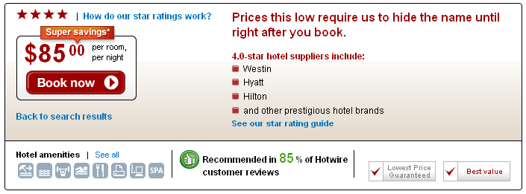
Answering Questions
Users are bound to have questions about our opaque products. We provide answers to their questions throughout the purchase flow but people still aren’t finding the answers. This is an area where we can improve.
This answer is buried under “Hotwire Hot Rate”, something the user might not care about.
This answer might be glossed over and missed.

Slide 32
Transparent Tradeoff
We need to make the tradeoff in our product more obvious.
Going out of business!
Everything 50% off. All sales final.
Yesterday’s Muffins
Half price
30% off your hotel room
Hotel revealed after you book
If discounts are deep enough, people will just want to buy.
They won’t ask why. We need to tell them why so they’re not surprised.
If there is a tradeoff, we need to make it clear immediately so they don’t find out later and then think that “there’s a catch”.

Slide 33
How does our tradeoff work?
We have a challenging tradeoff to explain. Even if people know what our tradeoff is, they might not understand how it works. They might be thinking:
Why does hiding the hotel name make it cheaper?
It’s easy to understand why a bakery can’t make yesterday’s muffin’s taste as fresh as today’s, and that yesterday’s muffins are not as fresh and are therefore discounted.
It’s more difficult to understand that a hotel has excess inventory, is willing to sell those rooms at a discount as long as people don’t know which hotel it is, but that those people will find out which hotel it is right after they buy it.
People probably think, “Why can’t you just tell me the hotel name?” but nobody is thinking, “Why can’t you just make yesterday’s muffins taste as fresh as today’s?”.
If we are perceived as holding back, making up strange rules, or generally trying to trick people, then it will be very hard for us to sell our product.

Slide 34
Distraction
In Priceline’s model, the user is preoccupied with bidding and distracted from thinking about the hotel identity.
What can we distract the user with?
We can emphasize the good part of the tradeoff, the benefits of our product.
Is there anything else we can distract them with?

Slide 35
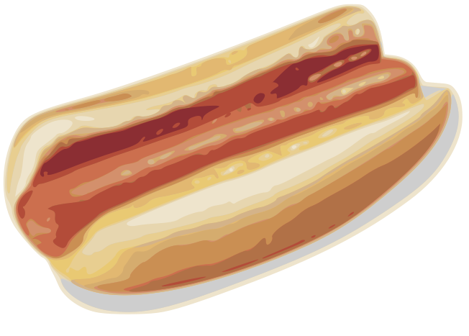
A hot dog costs 30% of $omething
It’s easier for people to think in dollar amounts than in percentages.
People know what dollars buy not what percentages of dollars buy.
When they hear of a discount, many people probably then have to convert percentages into dollar amounts.
People are more likely to say, “30% off, wow, that’s $20!” than “$20 off, wow, that’s 30%!” Dollars impress people.
In Priceline’s model, the exact dollar amount that they are saving each night is very obvious.
How can we make the dollar amount of savings more obvious?
2
$

Slide 36
Summary of Recommendations
Educate by placing opaque products alongside retail products.
Educate by using an icon that denotes the unknown.
Make the individual opaque product names drastically different from the individual retail product names.
Choose a general product name that is more informative about opacity than “Hot Rate” is.
Continue to be available to answer users’ questions about the product, and proactively approach those who may be confused and have questions.
Inform users of the tradeoff involved in opaque products immediately.
Explain how the tradeoff works, not just what it is.
Distract people from the bad part of the tradeoff by emphasizing the good part, which is the dollar amount that people are saving.

